Slide 1
Best Neighborhood in Pittsburgh

Slide 2
Introduction
When considering the best places to live in Pittsburgh we decided to focus on two categories: safety and cleanliness. The datasets we decided to use to demonstrate each neighborhoods safety and cleanliness were firearm seizures and smart trash cans. The neighborhoods that have a safer environment and a cleaner appearance are ones that we claim to be better.

Slide 3
Firearm Seizures
We chose firearm seizures because it gives insight on both the quantity of guns in the area and the rate at which they are being abused. The data set gave information on how many guns were seized, what type of gun it was and the location/neighborhood of the seizure. Therefore, the neighborhoods with less firearm seizures suggests that they are safer as there are fewer guns being misused.

Slide 4
Smart Trash Cans
We chose smart trash cans because the data set gave insight into how clean the neighborhoods are based on the amount of trash cans in the vicinity. It also provides information about how much that neighborhood cares about its appearance and its ability to modernize. Therefore, the neighborhoods with more smart trash cans are more inviting to live in as it boasts a cleaner appearance and more modern appliances.

Slide 5
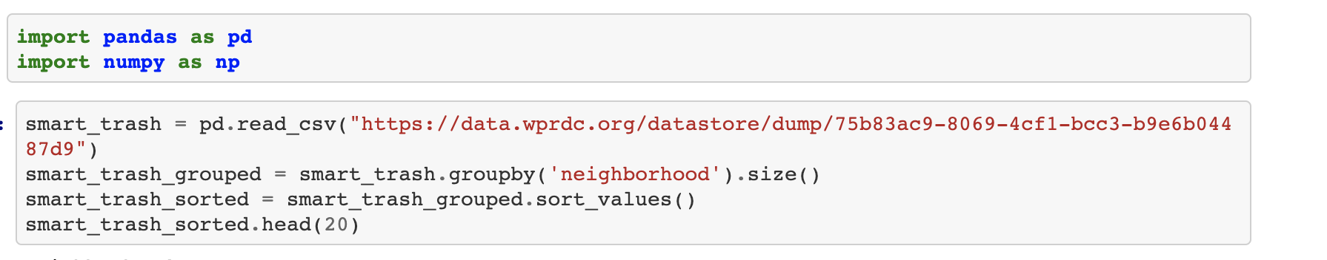
Gathering Smart Trash Data
The first step was to import the data by reading from the csv.

Slide 6
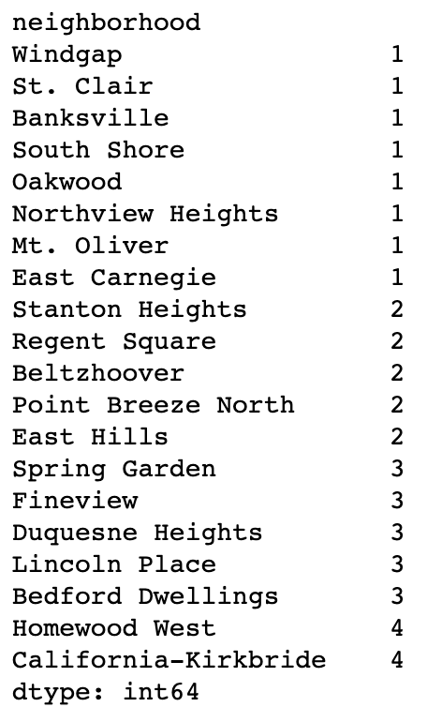
Initial Ranking
The data was summed and sorted and here is a yield of the first 20 results.

Slide 7
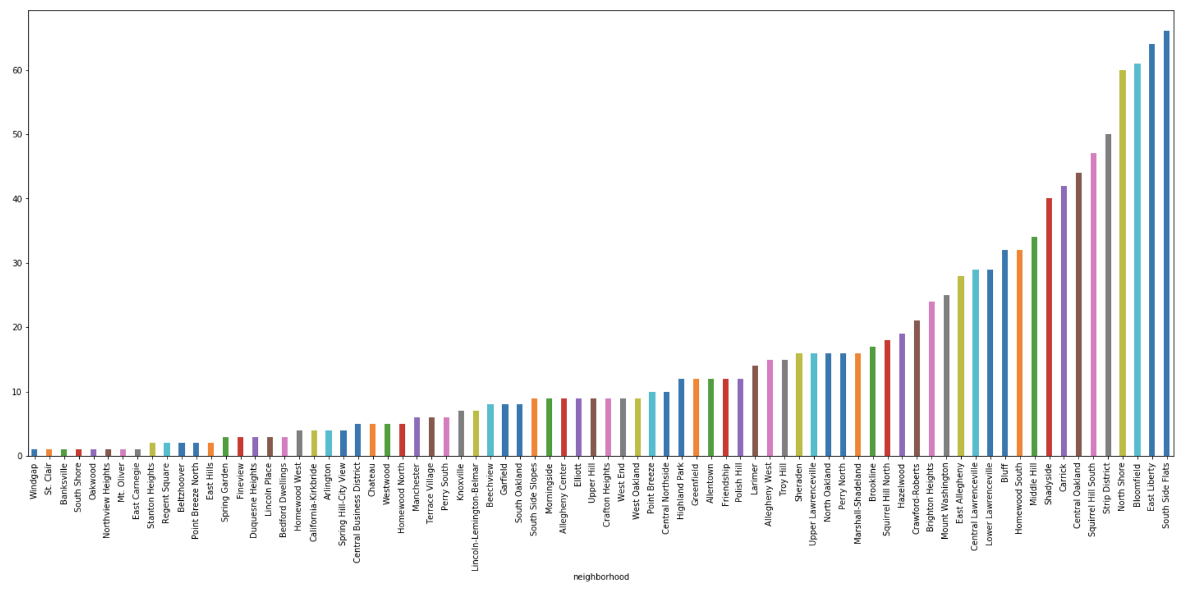
Smart Trash Graph

Slide 8
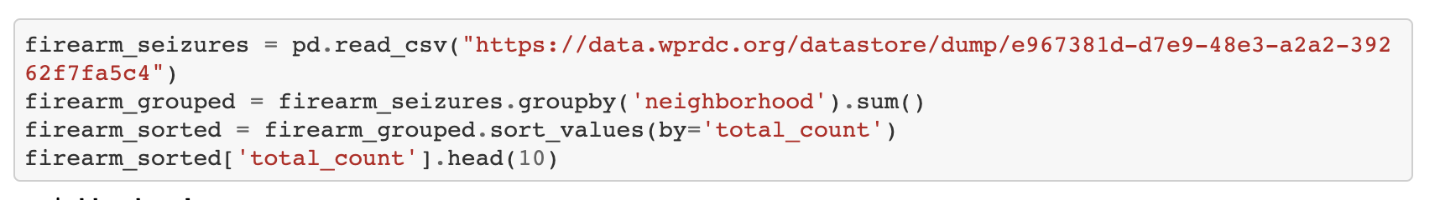
Gathering Firearms Data
We repeated this process with the firearms data by first importing and sorting the data.

Slide 9
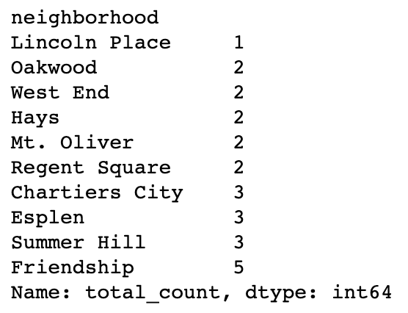
Initial Firearms Data
Here are the top 10 results from the sort through.

Slide 10
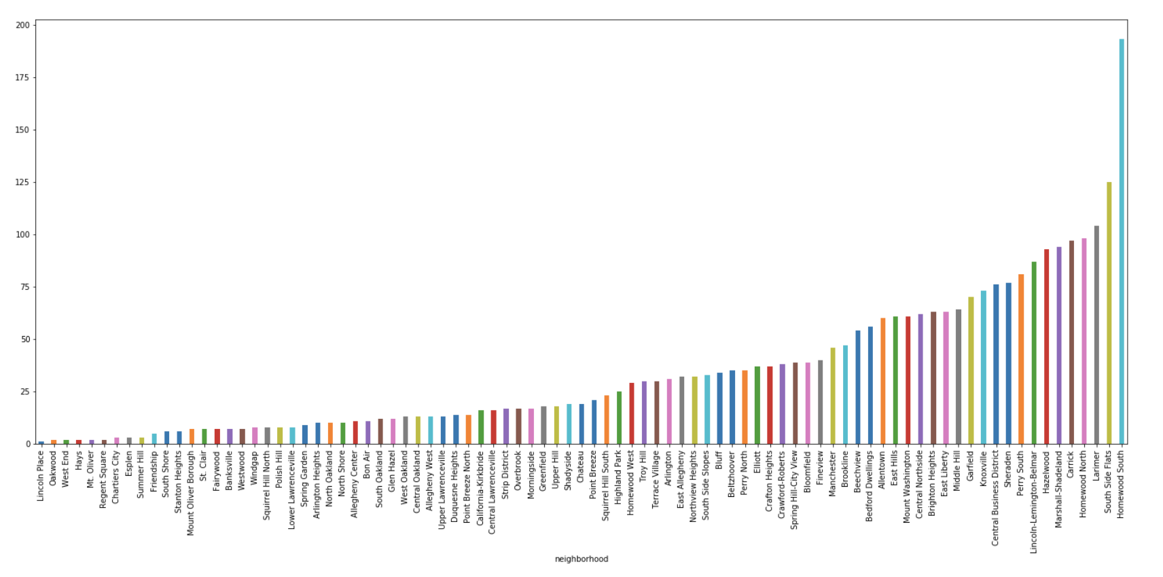
Firearm Graph

Slide 11
Combining the Data
In order to analyze the data we had to combine it in a way that created one overall value for each neighborhood. This was done by subtracting the amount of smart trash cans from the amount of firearm seizures as trash cans were a positive factor and firearm seizures were a negative factor. Therefore, the neighborhood with the lowest value is the best as it has the most trash cans relative to firearm seizures.

Slide 12
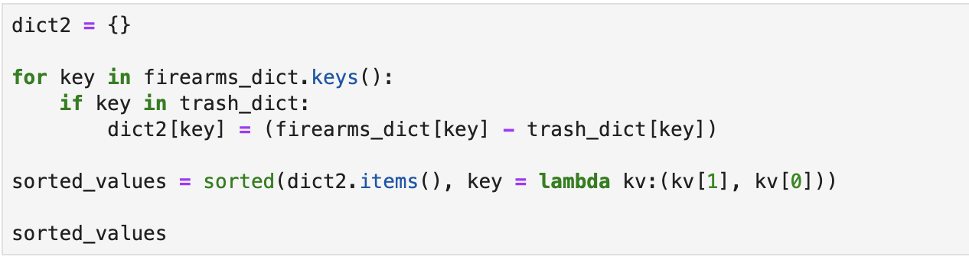
How the data was combined
We created dictionaries for the datasets and then subtracted the values of the trash from the firearms

Slide 13
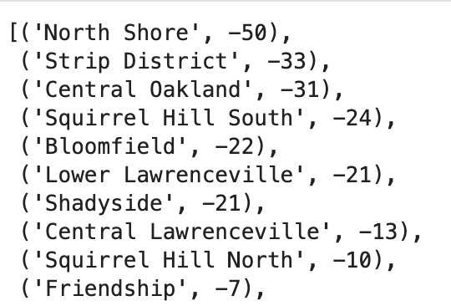
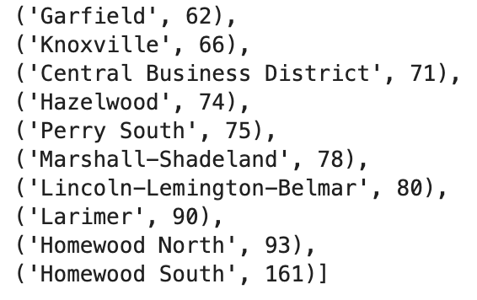
Final Sorted Data
Here are the top and bottom 10 results from the sorted dictionary.

Slide 14
Conclusion
In conclusion the neighborhoods with the least amount of firearm seizures and the most smart trash cans are the best places to live in Pittsburgh. Our data shows that the top 10 places to live are North Shore, Strip District, Central Oakland, Squirrel Hill South, and Bloomfield. The worst places to live are Homewood South, Homewood North, Larimer, Lincoln-Lemington-Belmar, and Marshal-Shadeland.

